Slide 1
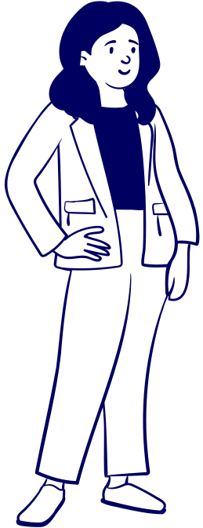

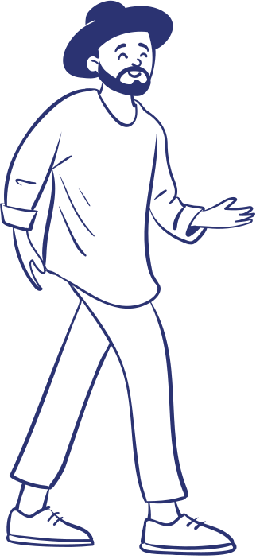


INTERVIEW SKILLS
For Professionals
Presented By:
Kumar Kartikain Shivam

Slide 2

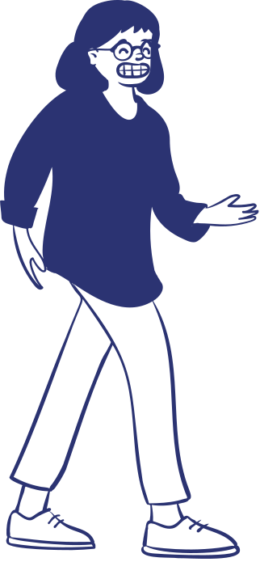


Interviews are nerve-racking.
No matter how many times you've gone through it, the thought of being interviewed can still make you feel nervous.
So WHAT to DO?
To ACE the Interview?

Slide 3
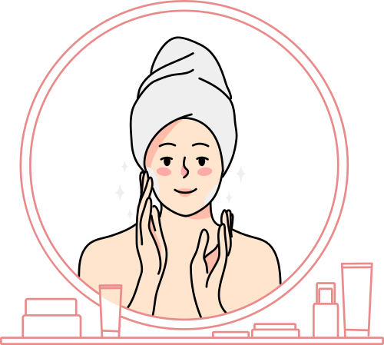
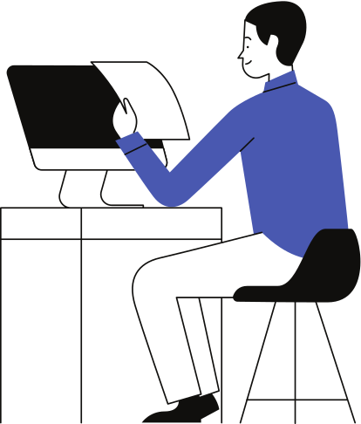
Prepare Beforehand
Research the Company
Study the Job Description
Prepare Your Responses
Dress the Part
Collect Documents
Plan Your Journey
Practice Etiquette
Prepare Questions
Manage Stress
Follow Up
To ACE the Interview

Slide 4
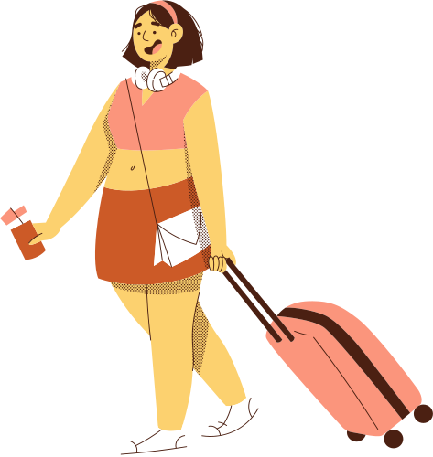
Documents
(CV, Cover Letter, LOR, Certificates etc.)
Pen & Notebook
Water Bottle
Cash & ID Proofs
Business Cards
(If needed)
Breath Fresheners
Grooming Articles
Placement
Kit

Slide 5

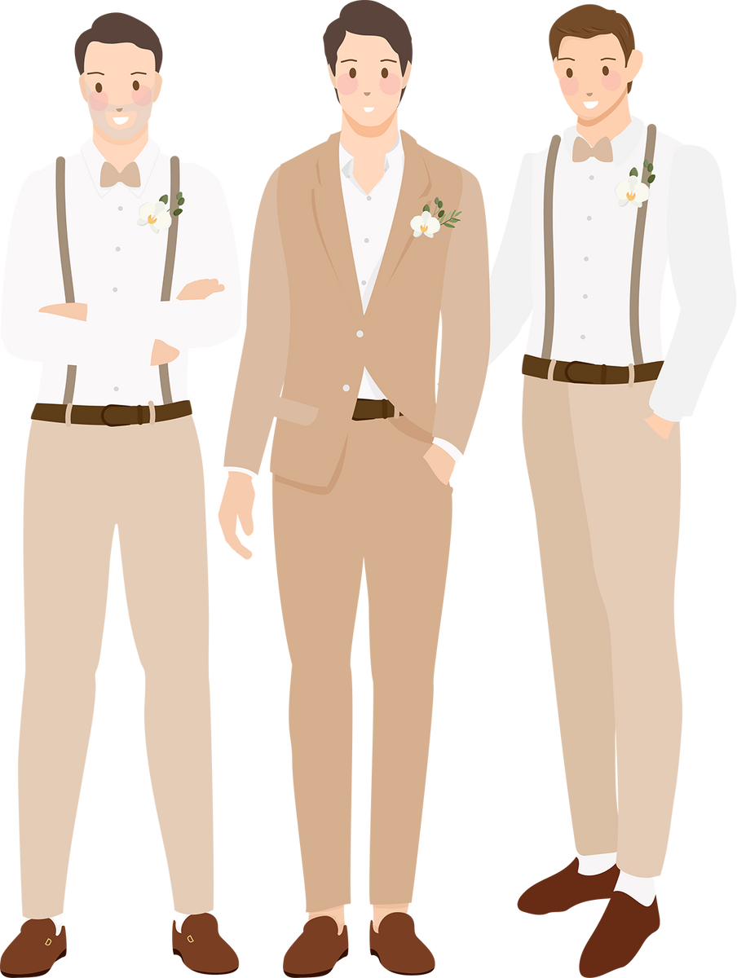


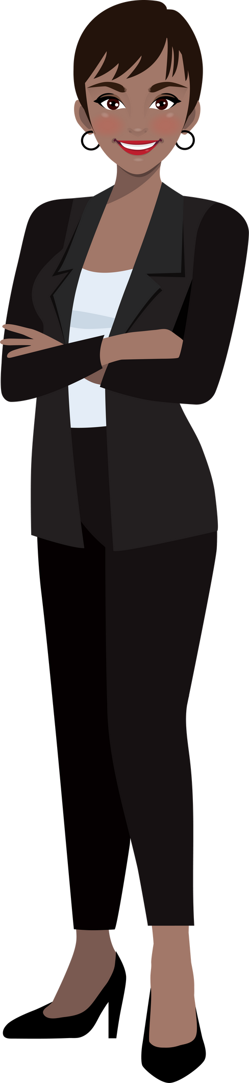
Prerequisites for grooming during interview,

Slide 6





Things to consider
Personal Hygiene:
Cleanliness
Well-Kept Hair
Trimmed Nails
Well-Maintained Teeth
01
Attire and Appearance:
Appropriate Professional Attire
Minimal Fragrance
Subtle Makeup
Shaved or Groomed Facial Hair
Accessories
Shoes
02
Behavior:
Confidence
Eye Contact
03

Slide 7
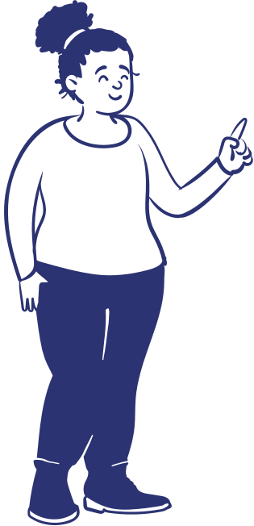

What does
the company want?
Study the job post and learn what kind of person the position needs. Keep in mind the company's principles and goals while evaluating every potential employee.

Slide 8


Types of Interviews
Structured Interviews: These interviews are highly organized and standardized. The interviewer asks a predetermined set of questions to all candidates. This type of interview reduces bias and ensures consistency in the evaluation process for senior or managerial positions.
Unstructured Interviews: In contrast to structured interviews, unstructured interviews are more conversational and open-ended. The questions can vary based on the candidate's responses, allowing for a deeper exploration of their qualifications and personality.
Panel Interviews: Panel interviews involve multiple interviewers who assess the candidate. Each panel member may have a different perspective or focus, making it a comprehensive evaluation process. Panel interviews are common

Slide 9


Types of Interviews
Behavioral Interviews: In behavioral interviews, candidates are asked to provide specific examples from their past experiences to demonstrate their skills and competencies. Interviewers assess how candidates handled previous situations as an indicator of future performance.
Group Interviews: Group interviews involve multiple candidates being interviewed simultaneously. This format is often used for assessing teamwork and collaboration skills. Group discussions or activities may be part of the process.
Phone or Video Interviews: Phone and video interviews are conducted remotely, making them a convenient option for initial screenings or for candidates who are geographically distant. Effective communication and a professional appearance are crucial in video interviews.

Slide 10
Types of Interviews
Stress Interviews: In stress interviews, candidates are intentionally put under pressure or asked challenging and unexpected questions to assess their ability to handle stress, think on their feet, and maintain composure.
Skype or Video Conference Interviews: Similar to video interviews, these are used when distance or remote work is a factor. They are more common for global or remote job positions.
Technical Interviews: Primarily used in technical and IT fields, these interviews assess a candidate's technical knowledge and problem-solving abilities. Candidates may be asked to complete coding tests or solve technical problems.

Slide 11

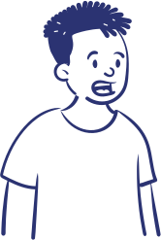
Answering Techniques for INTERVIEWS

Slide 12

Answer truthfully.
Use your notes and the
STAR technique:
(Situation, Task, Action, Results)
to write at least 5 stories from your experience related to the job description.

Slide 13
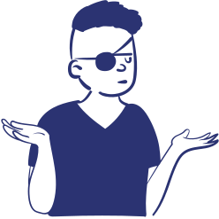
What does the company want?
This question is something both parties need to think about. Study the company you're applying for and prove why you're the person for the job.

Slide 14




Don’t Oversell yourself.
Remember that if you're going to be hired, you'll have to prove everything you said in your interview.
01
It's best to be honest about your skills so they have a clear picture of how you can contribute to the company.
02

Slide 15


Interview Etiquettes
For online interviews:
Test the technology beforehand to ensure that your microphone, speakers, and internet connection are working properly.
Dress professionally and choose a quiet location with minimal background noise and no distractions.
Practice your interviewing technique with a friend or family member to build confidence before the actual call.
Take notes throughout the interview to reference key points in a follow-up email or second interview.
Maintain eye contact and refrain from making unwanted hand movements like fidgeting or playing with your pen.

Slide 16

Interview Etiquettes
For face-to-face interviews:
Dress smartly and appear professional. Greet the interviewer with a smile and a firm handshake.
Be mindful of your body language, as it can play an important part in face-to-face meetings.
Maintain eye contact and refrain from making unwanted hand movements like fidgeting or playing with your pen.

Slide 17

Keep in contact.
Do not forget to leave your contact details with the interviewer.
Some companies are incredibly busy, so let them know you're still very much interested by asking about your application after some time.
But don't overdo this. Employers will get back to you sooner or later with results. Give them enough time to evaluate you and other applicants.

Slide 18

Be grateful for the opportunity.
Being turned down doesn't dictate
your worth as an employee.
01
Turn this into a learning opportunity and do better in the future.
02

Slide 19

Stay true to yourself.
In the span of your career, you'll be given plenty of opportunities to express yourself. Put your best foot forward and show why you're a great person to work with.

Slide 20

Reach Out to Me at
E Mail:
Kartikain.30819@lpu.co.in
I am here to Hear you out…

